Slide 1

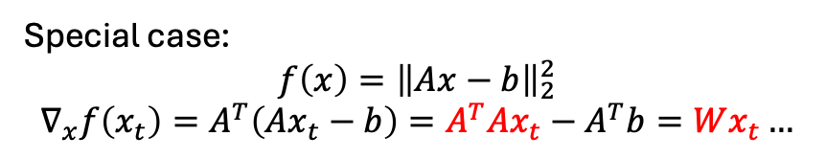

Motivation
$$\min_{x}{f(x)}$$
We do not know the close-form solution
The close-form solution is expensive
Gradient descent
$$∇_{x}f(x_{t})$$
Problem: Expensive because we need many computation over $t$
Special case:
$$f\left(x\right)={\left\|Ax−b\right\|}_{2}^{2}$$
$$∇_{x}f\left(x_{t}\right)=A^{T}\left(Ax_{t}−b\right)=A^{T}Ax_{t}−A^{T}b=Wx_{t}…$$

Slide 2

Base Solution
Quantization: Q(W), Q(x)->Q_w(W)Q_x(x)
Challenge: how to avoid the quantization error
Error 1: rounding error
Error 2: overflow
Determined by the data distribution
$$Wx_{t}≈WQ(x_{t})$$

Slide 3
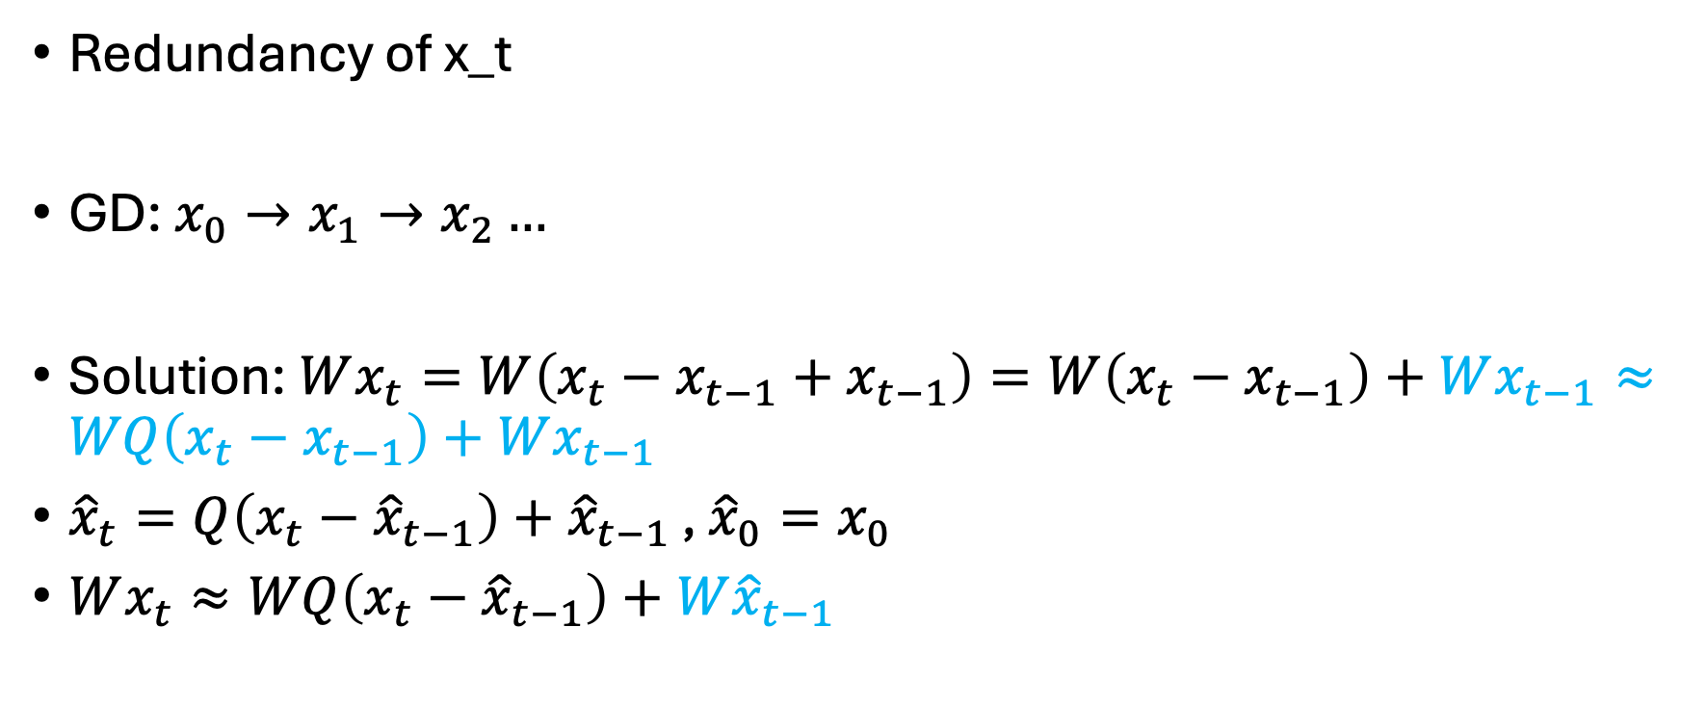
Target: reduce the quantization bit for x
Redundancy of x_t
GD: $x_{0}→x_{1}→x_{2}…$
Solution: $Wx_{t}=W\left(x_{t}−x_{t−1}+x_{t−1}\right)=W\left(x_{t}−x_{t−1}\right)+Wx_{t−1}≈WQ\left(x_{t}−x_{t−1}\right)+Wx_{t−1}$
${\hat{x}}_{t}=Q\left(x_{t}−{\hat{x}}_{t−1}\right)+{\hat{x}}_{t−1 }$, ${\hat{x}}_{0}=x_{0}$
$Wx_{t}≈WQ\left(x_{t}−{\hat{x}}_{t−1}\right)+W{\hat{x}}_{t−1}$

